Slide 1

summary:
Exploratory Data Analysis Using Python, I will explore the NYC MTA spinner
dataset. Track entrances and exits every four hours for turnstiles (UNIT) daily
in the subway system. Also calculate the total daily entries and exits. Also plot the daily time series of the revolving door. And integrating turnstiles into the same zone/unit/station control group. I want to merge the numbers together - for each ControlArea / UNIT / STATION group, for each day. From every revolving door belongs to this combo. Over the course of 12 weeks, I collect
and sort the total number of passengers for each station, so I can see which
stations have the highest traffic during the time I'm investigating

Slide 2
Variables included in initially processed data:
C/A = Control Area (e.g., A002)
unit = Remote Unit for a station (e.g., R051)
SCP = Subunit Channel Position represents an specific address for a device (e.g., 02-00-00)
station_code = C/A + unit, locating a station
turnstile = C/A + unit + SCP, locating a turnstile
Station = Represents the station name the device is located at
date = Represents the date (MM-DD-YY)
time = Represents the time (hh:mm:ss) for a scheduled audit event
datetime = date + time (MM-DD-YY hh:mm:ss)
desc = Represent the "REGULAR" scheduled audit event (Normally occurs every 4 hours)
entries = The comulative entry register value for a device
exits = The cumulative exit register value for a device

Slide 3
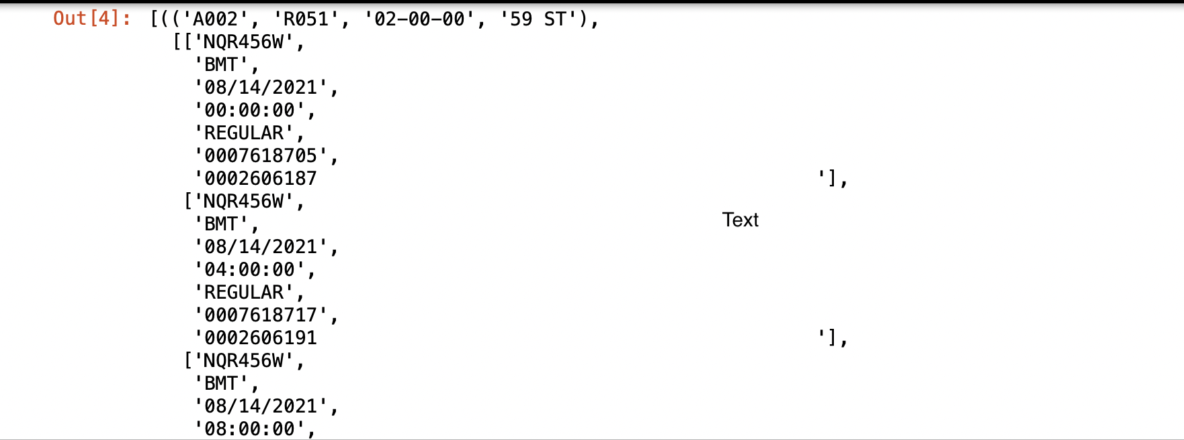
Download some MTA turnstile data files, and read the files).

Slide 4
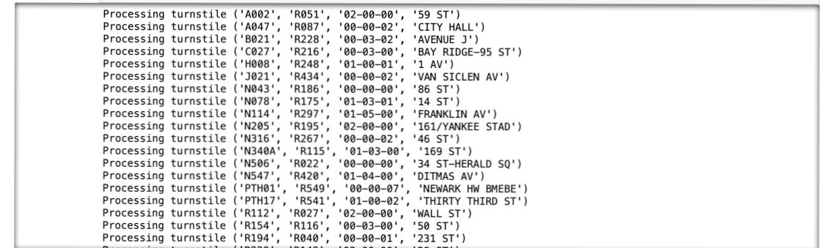
For each switch (essentially the control area, unit, device address, and a particular turnstile station), I have a list again, but let the list consist only of the time point and the cumulative number of entries. This basically means keeping only the date and time fields and entries in each list. You can convert datetime to datetime objects - this is a python class that represents a point in time. Date and time fields can be combined into a string

Slide 5
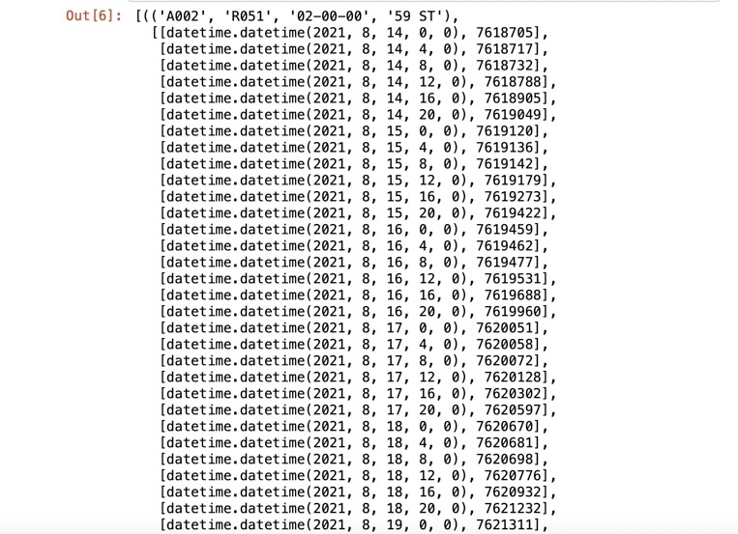
These numbers are cumulative every n of hours. I want total daily entries.
Now I made sure I had the same keys again, but now I have 1 value for a day, which is not cumulative numbers but the total number of passengers who entered through this turnstile on that day.

Slide 6
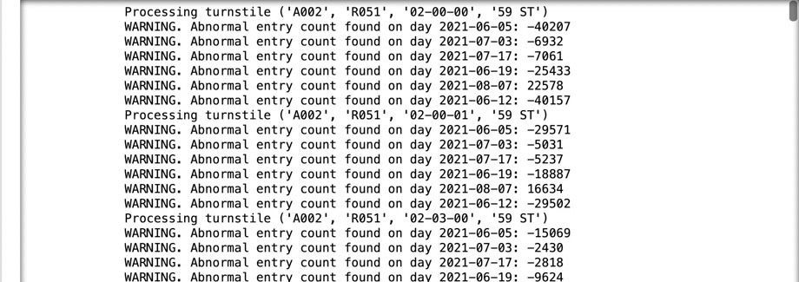

Slide 7
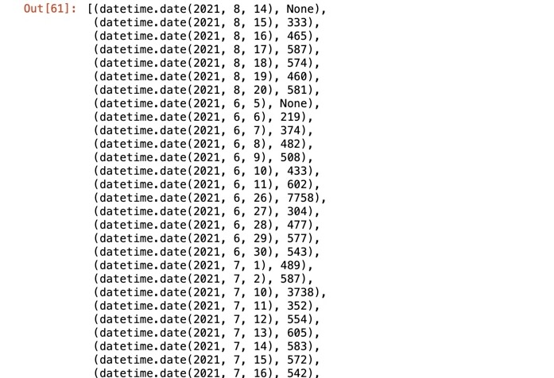
Total daily entries for a particular turnstile station.

Slide 8
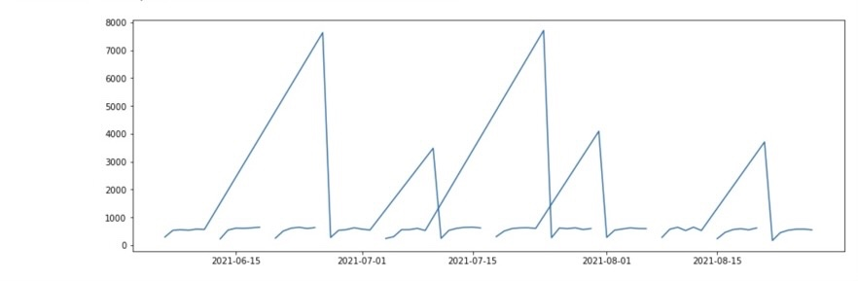
Revolving door of the daily time series plot

Slide 9
Combine turnstiles in the same control group / unit / station control area.
There are some ControlArea/Unit/Station combinations that have one turnstile, but most have multiple pedals - same value for C/A, UNIT and STATION shafts, different values ​​for SCP shaft.
I want to merge the numbers together - for each ControlArea/UNIT/STATION group, for each day, add the counts from each turnstile that belongs to that combo.

Slide 10
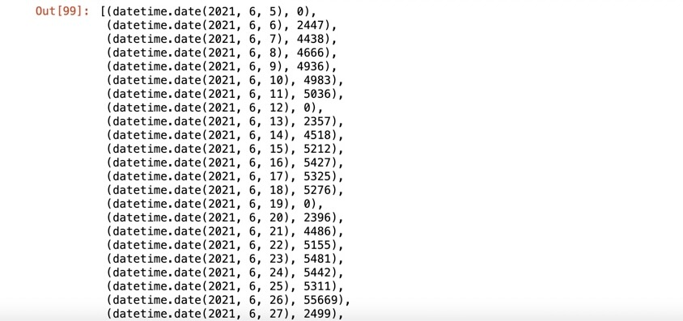

Slide 11
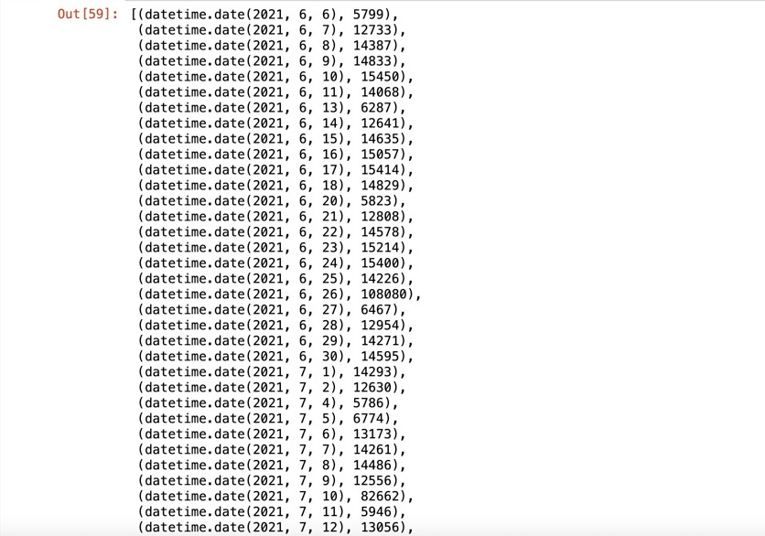
Collect everything at each station, and come up with a time series type of time series for each station, by adding all the turnstiles in the station.

